Slide 1
Dish Name Extraction from Review Corpus
T. Mikolov et al., Efficient estimation of word representations in vector space, ICLR 2013
T. Mikolov et al., Distributed Representations of Words and Phrases and their Compositionality, NIPS 2013

Slide 2

Why This Project?
I had previously built a restaurant ranking based on dish names using Yelp review corpus (features: dish count, review date/rating, reviewers review count and friends count)
The project needed dish name extraction from corpus
Menu items were missing in some restaurant listings
Some of the menu items were image
I used the word2vec algorithm to extract dish names.
Will discuss the two research papers that I used to get the results and discuss the derivations in detail.

Slide 3
Index
Algorithm description
Word2vec (skip-gram version)
Naive softmax implementation
Negative sampling to improve efficiency
Data preparation
Data pre-processing, Bi-gram phrasing
Results and discussions
Notes:
Discuss in-depth the paper, the modeling, the evaluation and the application, evaluation metrics, data representing the training process, derivations etc
Why skip-gram was chosen ?, tell about the downside of cbow in building a good word embeddings for low freq words like the dish names. Additionally talk about the limited training set and the advantage of using SG.
Skip-gram: works well with small amount of the training data, represents well even rare words or phrases.
CBOW: several times faster to train than the skip-gram, slightly better accuracy for the frequent words
In the "skip-gram" mode alternative to "CBOW", rather than averaging the context words, each is used as a pairwise training example. That is, in place of one CBOW example such as [predict 'ate' from average('The', 'cat', 'the', 'mouse')], the network is presented with four skip-gram examples [predict 'ate' from 'The'], [predict 'ate' from 'cat'], [predict 'ate' from 'the'], [predict 'ate' from 'mouse']. (The same random window-reduction occurs, so half the time that would just be two examples, of the nearest words.)
https://stackoverflow.com/questions/38287772/cbow-v-s-skip-gram-why-invert-context-and-target-words

Slide 4
Extracting Word Meanings
You shall know a word by the company it keeps - (Firth, J. R. 1957)
only liked bhel puri out of everything we had
the chef gave us complimentary veg pakora
no where close to authentic chaats
ordered a bunch of things here sev puri, ...
Notes:
All the dish names seems to follow a pattern (surrounded by similar context words). Next few slides discusses a neural architecture that exploits this property to extract word embedding’s.

Slide 5
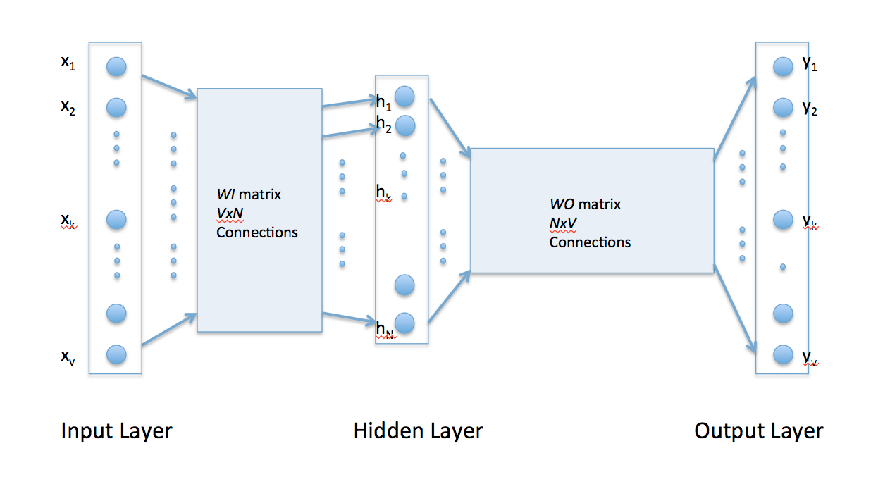
Model Architecture (basis of CBOW, Skip-Gram)
SOFTMAX
V Dimensional one-Hot input word vector
N dimensional embedding vector
V dimensional vector representing context word probabilities
Notes:
Word embeddings (vector representation of words) are built by maximizing the normalized inner product of the target word vector with its surrounding context word vectors. This is achieved by a neural embedding architecture as shown above.

Slide 6
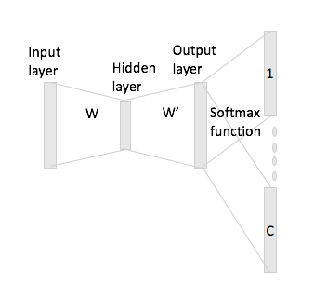
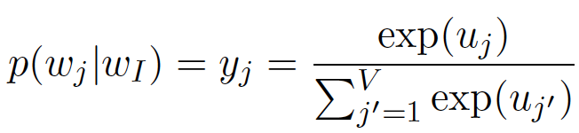
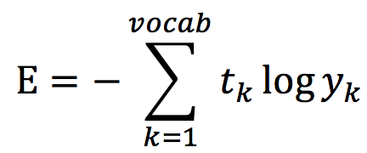
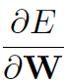
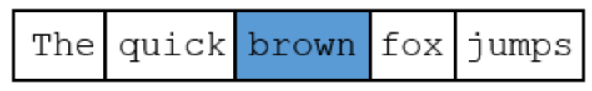
Model Architecture (Skip-Gram with Naive Softmax)
Forward Propagation
Output = Prob of context words
Error function per context word
Backward Propagation
Calculate
Use them to update W, W’ matrix
{t_{k}=1 for k=context words}
,
Notes:
The architecture is similar to last page. Here for a given target word “brown”, the arch predicts “the”, “quick”, “fox”, and “jumps” as highly probable context words.
All the “c” context word panels are same vector values of length = v (v = num of words in vocabulary). E will be different for different panels (based on which context word is trained for that panel) that are used to back propagate the error value E. Here panel denotes one of the context word in the skip-gram arch.

Slide 7
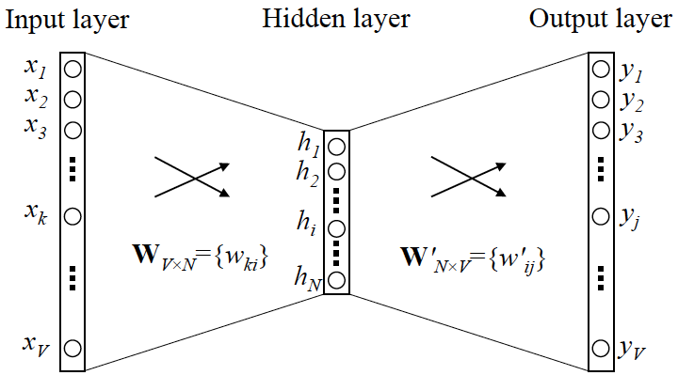

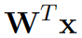


Forward Propagation (Skip-Gram - Naive Softmax)
Error function
{t_{k}=1 for k=context words}
h =
u_{j} = h
y_{j} = softmax(u_{j})
Forward Propagation
Notes:
h = word embedding vector (a single row selected from input embedding matrix W) for the target word ‘x’ (one-hot vector representing the target word)
u = inner product of h with context embedding vector (from output embedding matrix W’)
y = softmax(u)

Slide 8
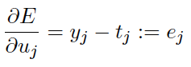
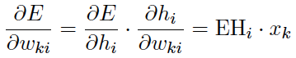
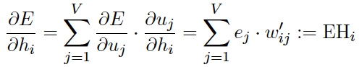
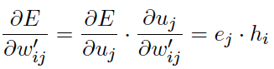
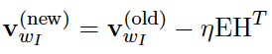
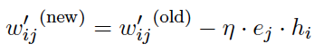
Back Propagation (Skip-Gram - Naive Softmax)
Error function per context word
Backward Propagation
Complex derivation - A1
Notes:
https://arxiv.org/pdf/1411.2738.pdf
Softmax derivative, and Error function derivative explained - https://math.stackexchange.com/questions/945871/derivative-of-softmax-loss-function
Both the embedding vectors (input matrix W and output matrix W’) are updated for every target, context training data in the corpus.
Running such training once on the whole corpus is considered as one epoch.
Based on the learning rate (eta), one needs to run it for multiple epochs to get accurate embedding vector representation.
After the training is complete, we discard the output matrix W’ and keep only the input matrix W to analyze word clustering.
One may ask why there are two word embedding matrix. Cant W’ be a transpose of W. If we think about it intuitively, W’ should be different from W, so that the inner product of the target word vector (from W) and context word vector (from W’) that are trained to give maximum value will not lead to undesirable results. In other words, lets assumed that we make the W and W’ to be a transpose of each other, then the context words will have vectors that are very similar to target words (similar vector values lead to max inner product value). In other words, in an example training shown in one of previous slide ( “The Quick Brown Fox Jumps” ) the target word “brown” would then end up having “the”, “quick”, “fox”, “jumps” as nearest neighbors. This is undesirable result. Instead the embedding vector should only learn the target word and create an embedding vector that is in context with its context words, not close close in cosine distance to the context words.

Slide 9
Model Implementation
Implemented the word2vec algorithm (skip-gram) to extract word embeddings.
Implemented a bare-bones python code that could only work with 100 reviews (out of 75K) with 40 embedding vector dimension.
Tensorflow implementation with negative sampling worked with full corpus (that will be shown later)
Have used below setting to extract the word embeddings.
Embedding vector dimension = 40
max_vocabulary_size = 2000 # Total number of different words in the vocabulary
min_occurrence = 1 # Remove all words that does not appears at least n times
skip_window = 4 # How many words to consider left and right
Epoch = 1000
Notes:
Tried 10,20,40 embedding vector size and got best results for 40 for dish name clustering.
The bare-bones naïve python implementation could only handle 100 reviews (which had a total of <=2000 distinct vocabulary)
Tensor Flow implementation of skip-gram arch was successful in handling the full corpus (75K restaurant reviews)

Slide 10
Data Preparation
75K Restaurant reviews collected from 185 restaurants in bay area.
6 Million words in corpus, with 150K distinct words in vocabulary
Review corpus was prepared by removing punctuations and other special characters
Bi-gram phrasing was applied to cluster high probable co-occuring words (Ex:- food bigrams) by maximizing the value of p(w1w2)/p(w1)*p(w2), where p(w) = probability of a word occuring in the corpus.
This is done so that the dish name extraction can be done and can be used for qualitative evaluation of the algorithm.
Notes:
Review corpus is cleaned, and bi-gram phrasing is applied.

Slide 11
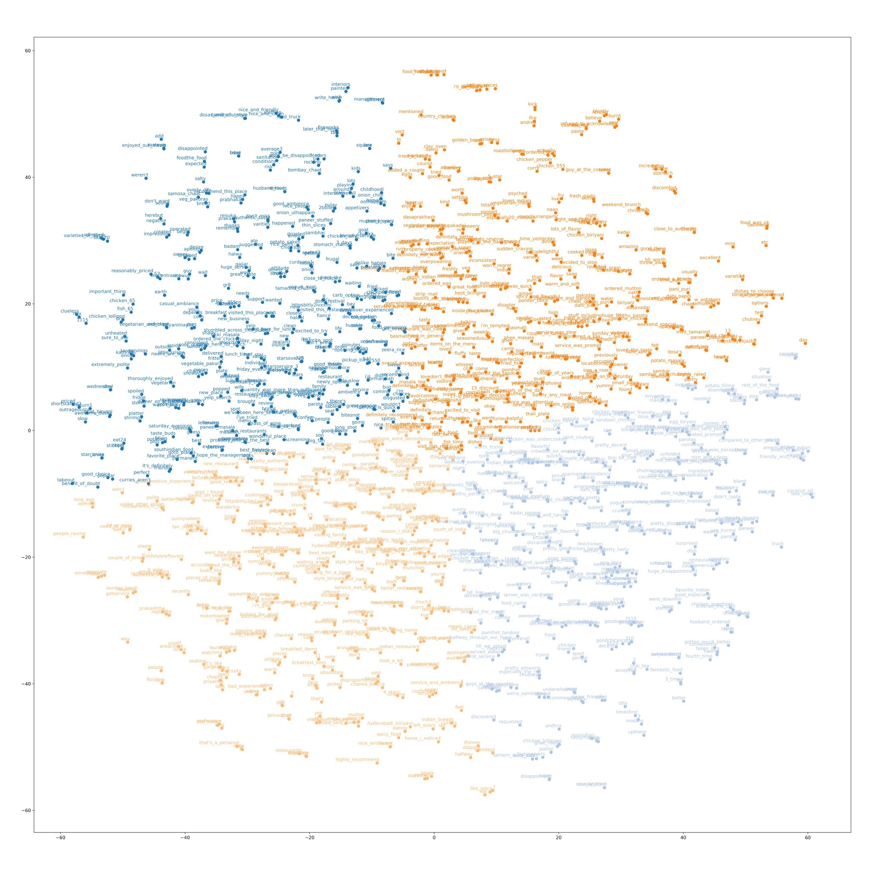
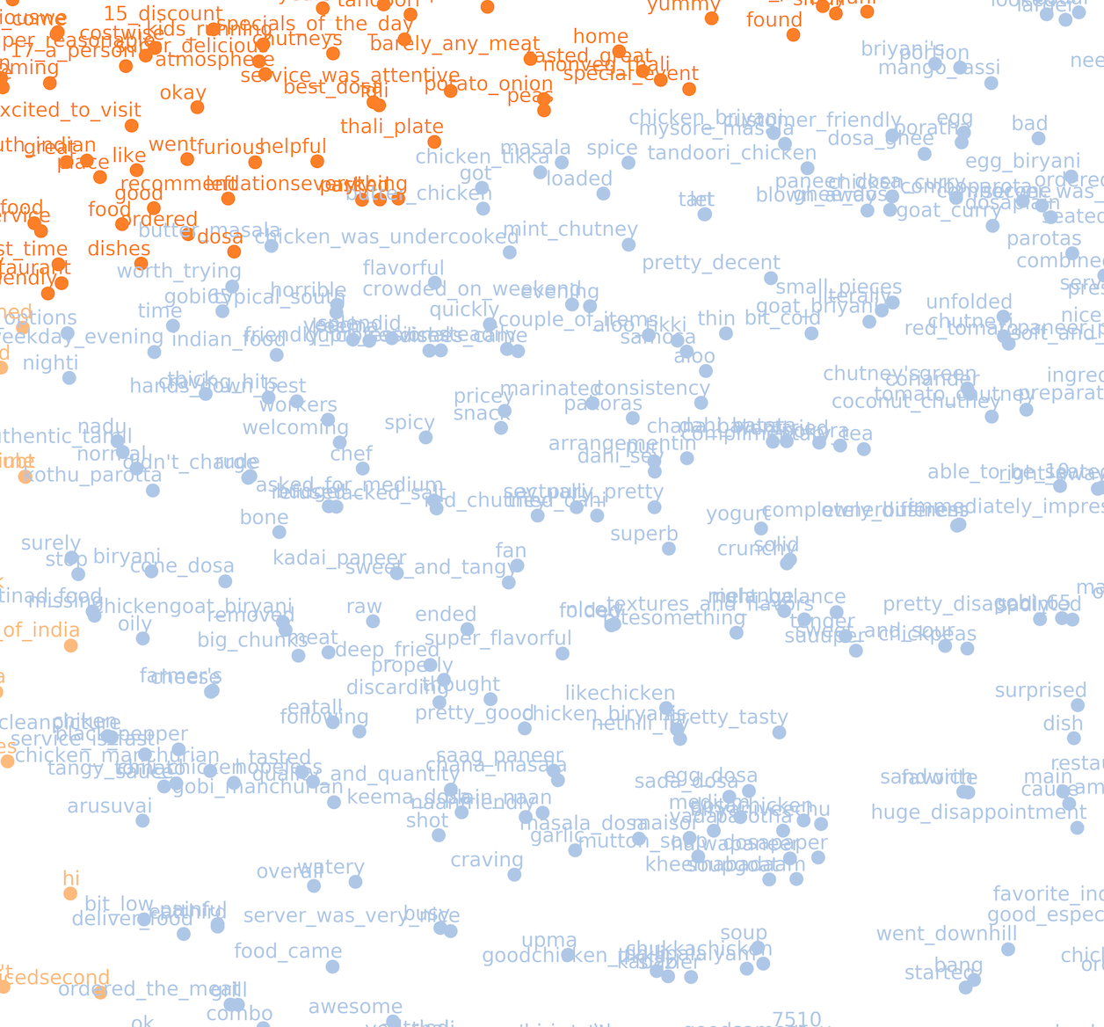
t-SNE Projection of 40D Embeddings to 2D
Naive softmax was run only on 100 reviews with limited vocab having fractional dishnames. Cluster showing dish names shown below.
Notes:
40 dimension word embedding's are reduced to 2D using PCA for visualization purpose.
K-means clustering is run on 2D word embedding's to extract the cluster methodologically.
Each cluster denotes a meaningful neighborhood, in this case, the light blue cluster contains most of the dish names.

Slide 12
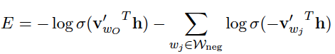
Speed Optimization (Negative Sampling)
Forward Propagation
Output = Prob of context words
Error function
Backward Propagation
Calculate using only context
and negative words (instead of whole vocab).
Use them to update W, W’ matrix
Complex derivation - A2
,
Notes:
https://arxiv.org/pdf/1411.2738.pdf

Slide 13
Model Implementation
Implemented the word2vec algorithm (skip-gram) to extract word embeddings.
Tensorflow implementation with negative sampling worked with full corpus.
Have used below setting to extract the word embeddings.
Embedding vector dimension = 50
max_vocabulary_size = 150000 # Total number of different words in the vocabulary
min_occurrence = 1 # Remove all words that does not appears at least n times
skip_window = 3 # How many words to consider left and right
num_sampled = 64 # Number of negative examples to sample
Mini_batch_size = 128 # training set size per mini-batch
Total_steps = 12e6
Notes:
Tensorflow w2v settings

Slide 14
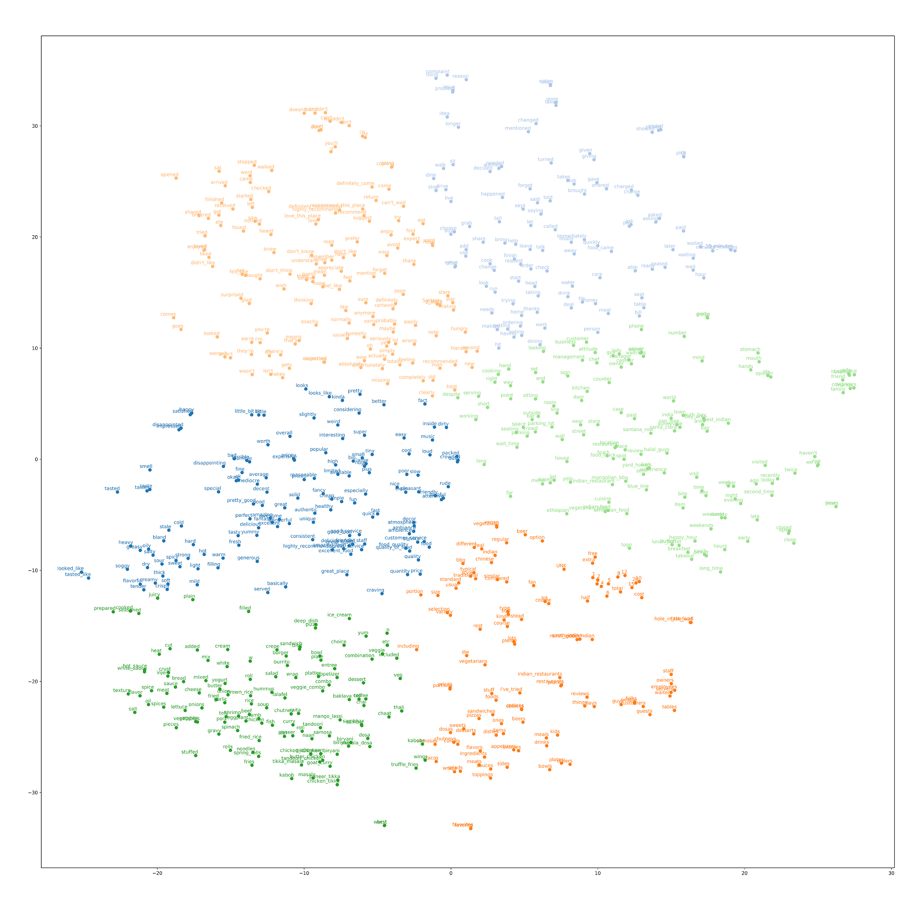
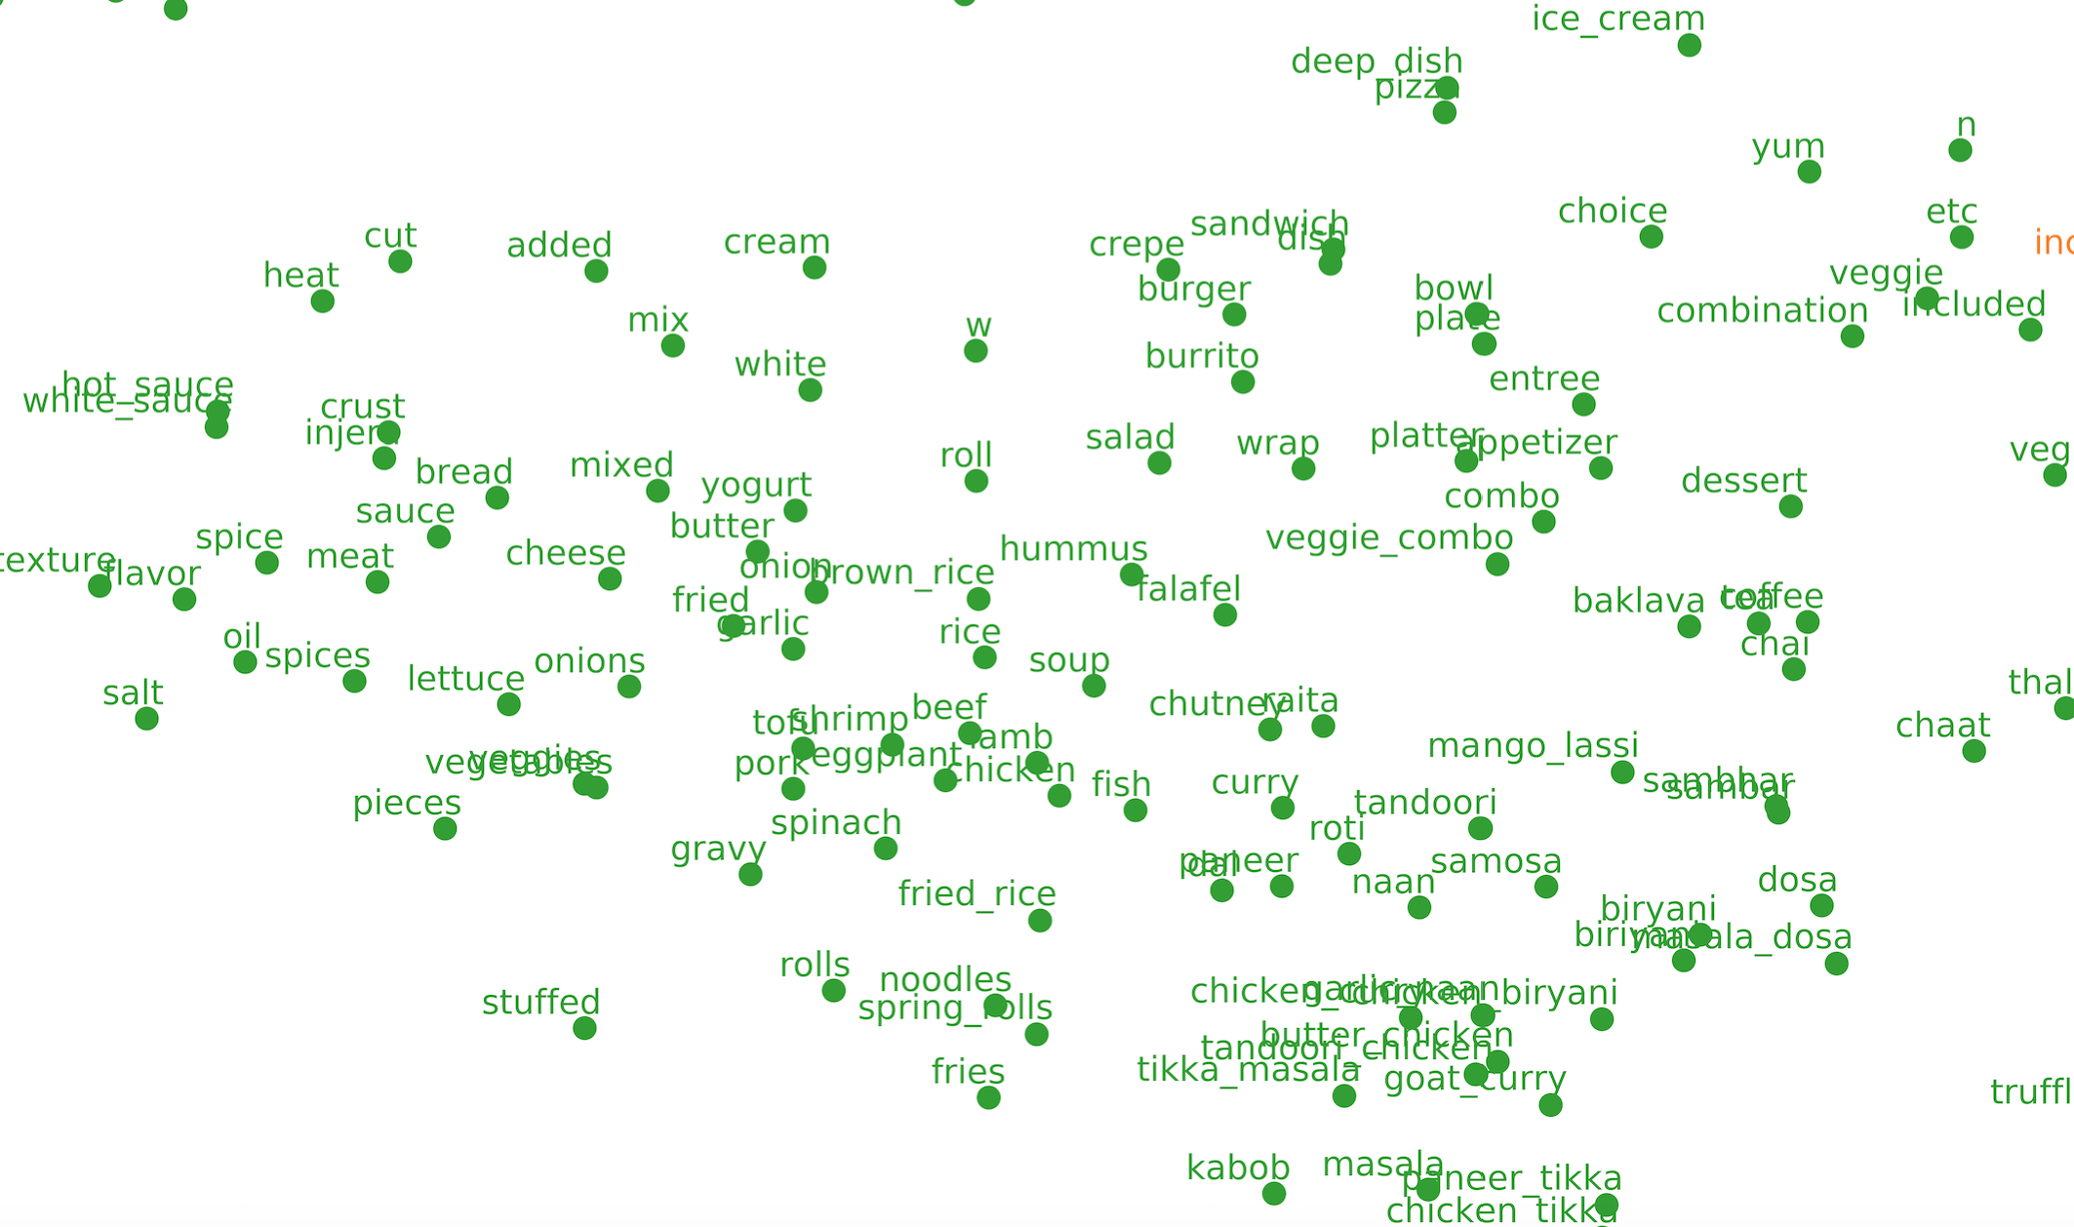
t-SNE Projection of 50D Embeddings to 2D
Though the whole corpus was run, for visualization purposes, picked 1000 random words from 150K vocabulary. The dish-names are better clustered here compared to the naive softmax run.
Notes:
50 dimension word embedding's are reduced to 2D using PCA for visualization purpose.
K-means clustering is run on 2D word embedding's to extract the cluster methodologically.
Each cluster denotes a meaningful neighborhood, in this case, the dark green cluster contains most of the dish names.

Slide 15
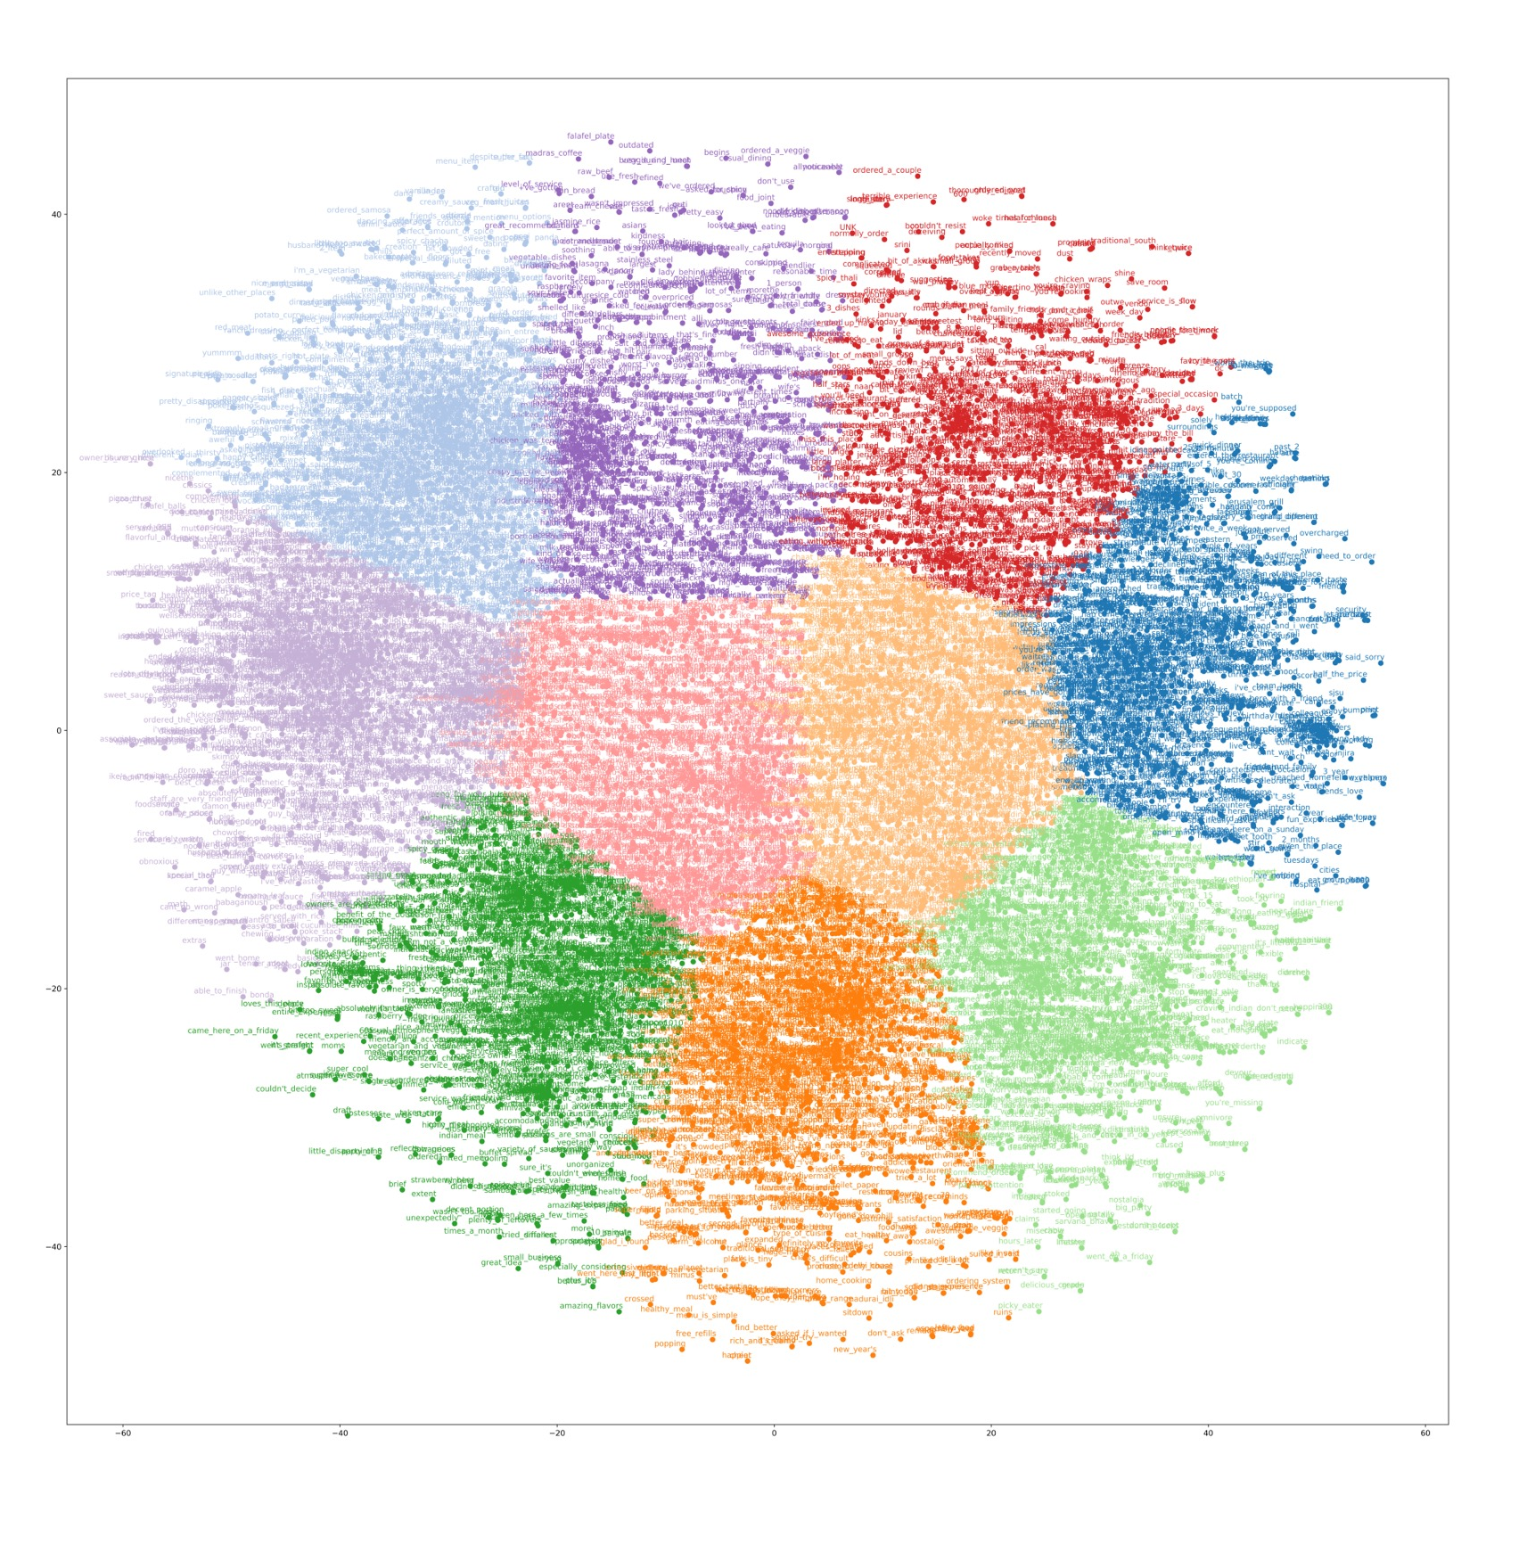
t-SNE Projection of 50D Embeddings to 2D
Note that I have only applied t-SNE on 10000 random words from 150K vocabulary. Hence the cluster has more number of dish names.
Notes:
50 dimension word embedding's are reduced to 2D using PCA for visualization purpose.
K-means clustering is run on 2D word embedding's to extract the cluster methodologically.
Each cluster denotes a meaningful neighborhood, in this case, the dark green cluster contains most of the dish names.

Slide 16
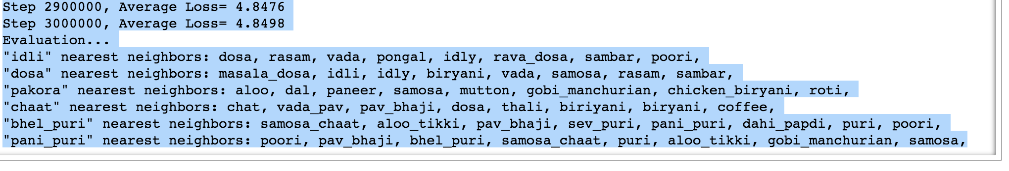
Snapshot of the algorithm cosine-sim results
Top-10 across 2 cuisines
Interestingly, north and south-Indian dishes were clustered separately (as shown above), showing that the architecture is not only useful in extracting dish-names but can also identify cuisine clusters.
Notes:
North Indian and South Indian dish names are clustered separately.
Highlight north indian and south indian dishes.

Slide 17
Calculate precision metric w.r.t GenSim
I am using a precision metric to track the efficiency of my implementation
GenSim package is used to get true positives and compare my implementation against it.
Precision = How many of the top-1000 nearest dishnames predicted by my implementation were present in Gensim top-5000
Notes:
Use precision and recall measure, fetch true positives from GenSim predictions. Make sure the neg sampling # is same in both gensim and TF.

Slide 18
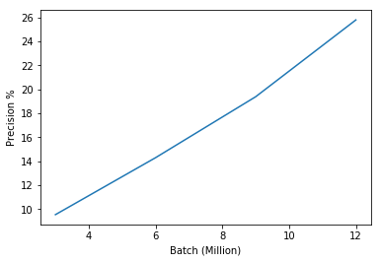
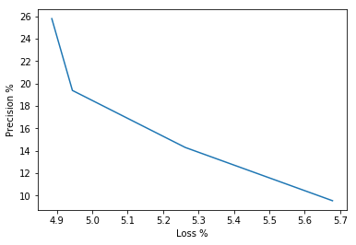
Calculate precision metric w.r.t GenSim
Mini-batch training steps versus precision
Training loss verus precision
Notes:
The results above are presented for 6 selected dish names (precision of the nearest neighbors to these 6 dish names) whose nearest neighbors are calculated and compared against Gensim predictions.
Mini-batch size = 128 (target, context word) training data

Slide 19
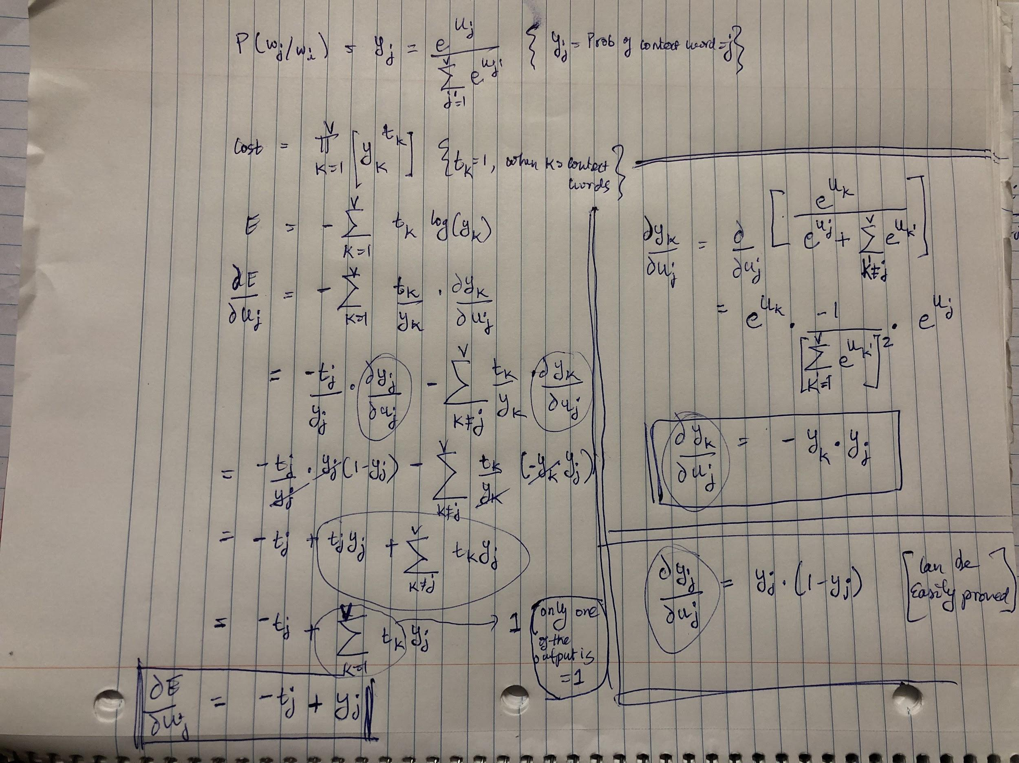
Appendix A1 - Softmax prediction error
Notes:
Softmax derivative, and Error function derivative explained - https://math.stackexchange.com/questions/945871/derivative-of-softmax-loss-function

Slide 20
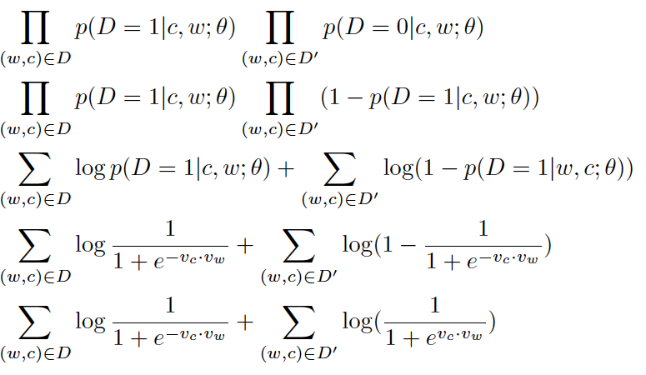
A2 - Error Function Derivation (Negative Sampling)
=
Optimization objective
=
=
=
- Loss Function
=
The negative sample D’ are chosen from vocabulary based on unigram distribution raised to power of ¾.
Notes:
https://arxiv.org/pdf/1402.3722v1.pdf

